Slide 1
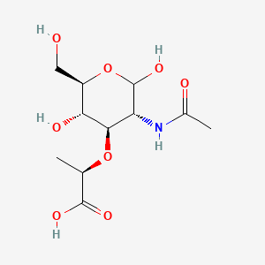
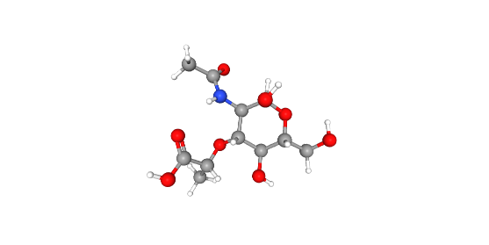
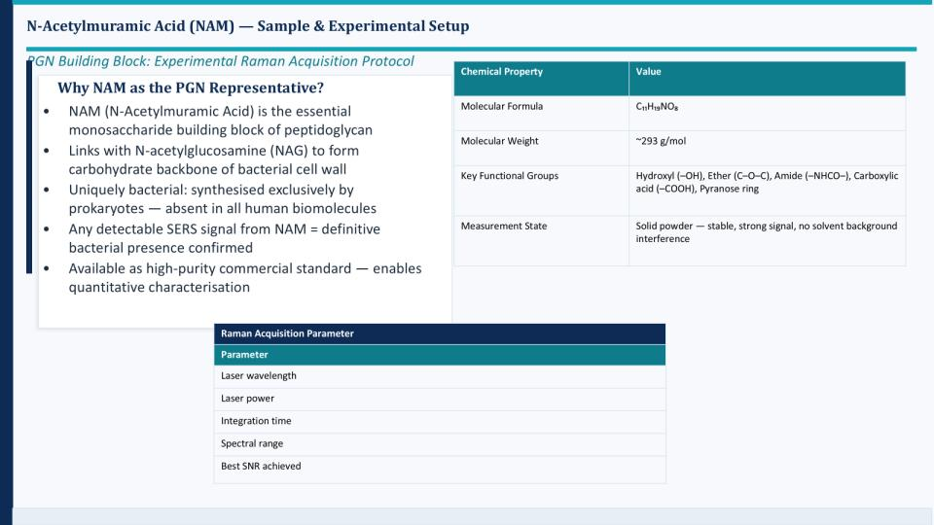
Raman–DFT Analysis of N-Acetylmuramic Acid (NAM)
2D Structure
3D Structure

Slide 2
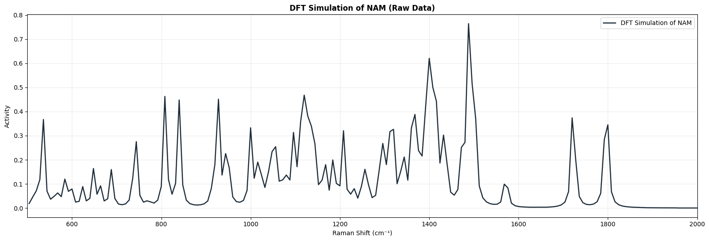
Raman Measurement
DFT Simulation Parameters (NAM)
Software: Gaussian 16
Method: B3LYP / 6-31+G(d,p)
Calculation: Opt (Tight) + Freq (Raman)
Geometry: Connectivity defined
Resources: 16 cores, 56 GB RAM
Parameter | Range
Laser wavelength | 785 nm
Laser power | 10–80 %
Integration time | 10–25 s
Spectral range | 200–3000 cm⁻¹
Raman Data Processing
Spectra were preprocessed before analysis.
Processing pipeline:
Dark subtraction
Savitzky–Golay smoothing
Baseline correction (ALS)
Normalization
Peak detection
SNR calculation

Slide 3
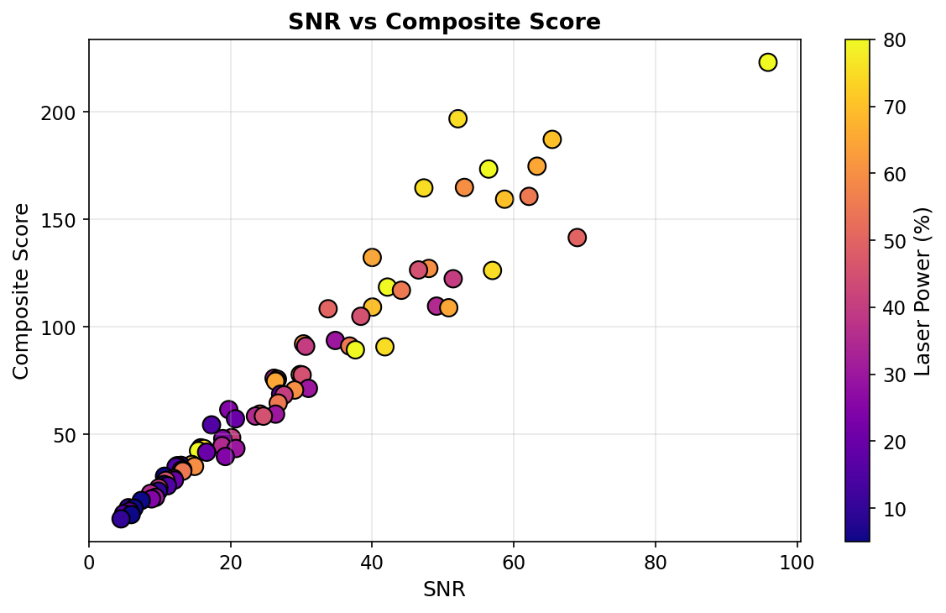
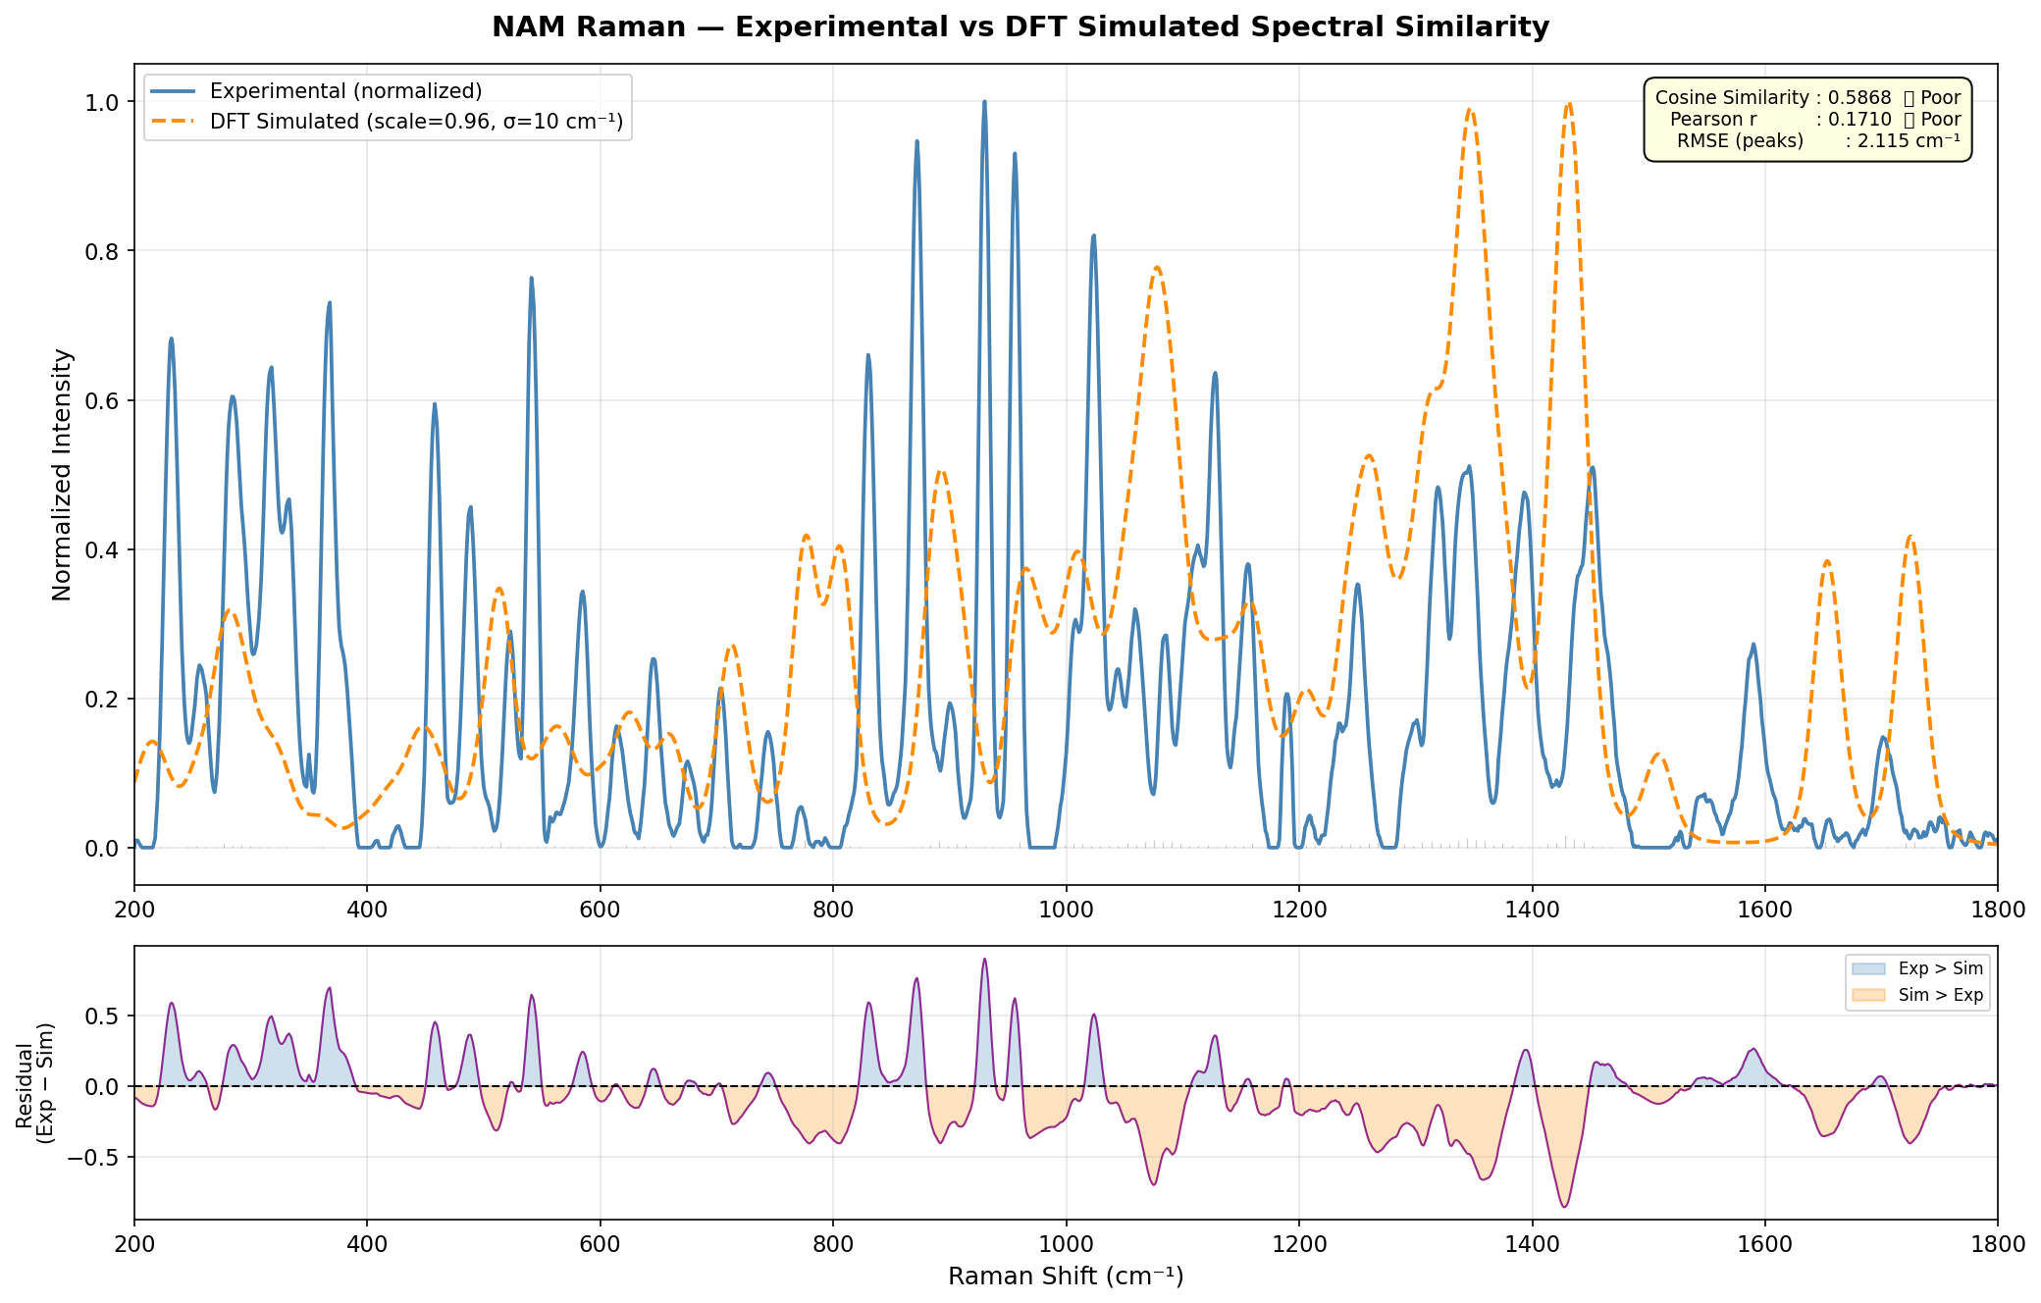
Parameter | Value
Integration time | 25 s
Laser power | 80 %
Best SNR | 95.9
Optimal Raman Parameters
These settings produced the highest quality spectrum.
> 80 = Excellent
SNR Interpretation:
>80 → Excellent
50–80 → Very Good
30–50 → Good

Slide 4
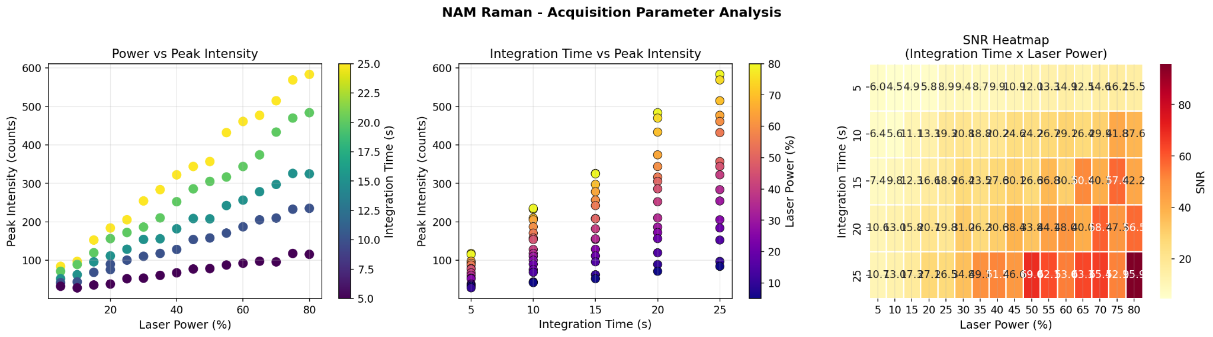
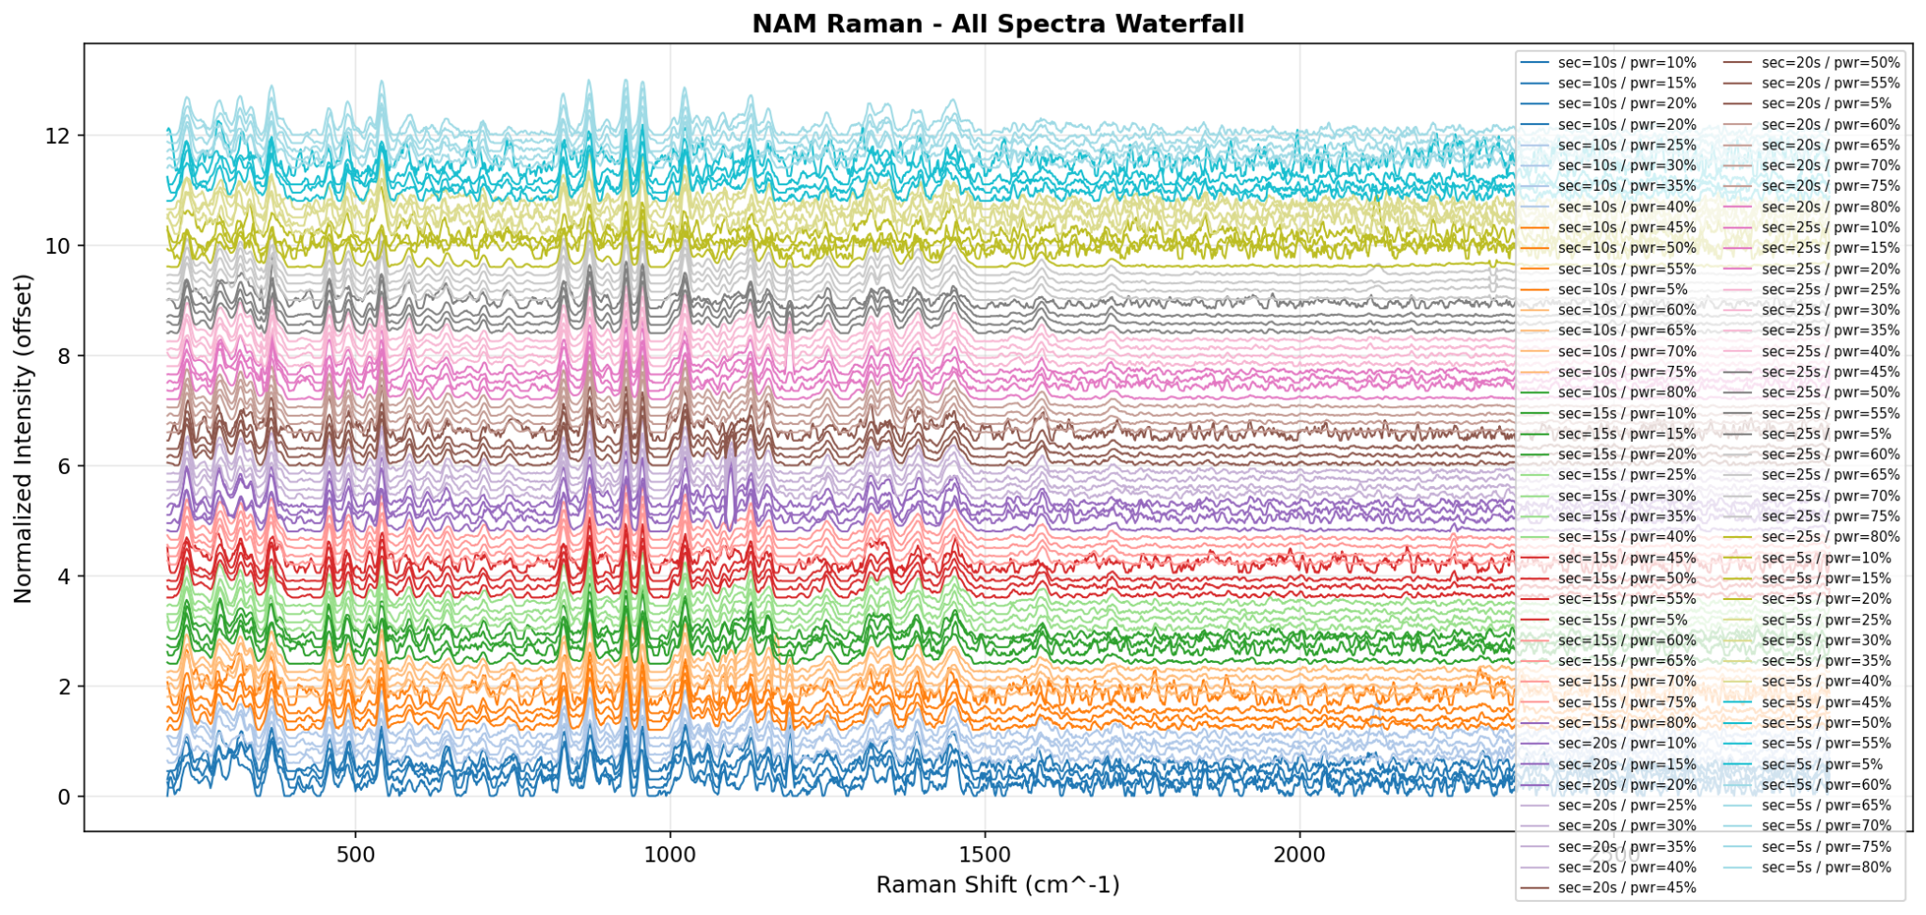
Acquisition Parameter Analysis

Slide 5
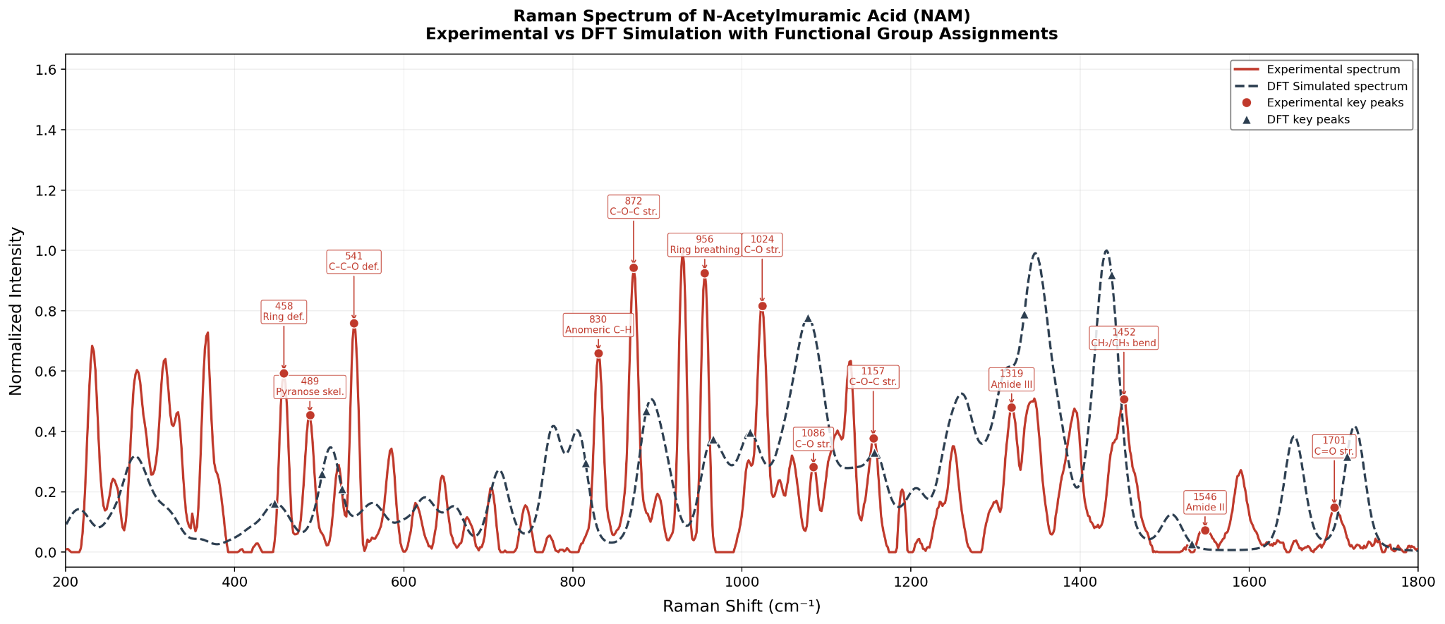
Raman Peak Assignments
Raman Shift | Assignment
1701 | C=O stretch
1546 | Amide II
1452 | CH₂ bending
1086 | C–O stretch
872 | C–O–C stretch
956 | Pyranose ring breathing
C=O stretch
C–O stretch

Slide 6
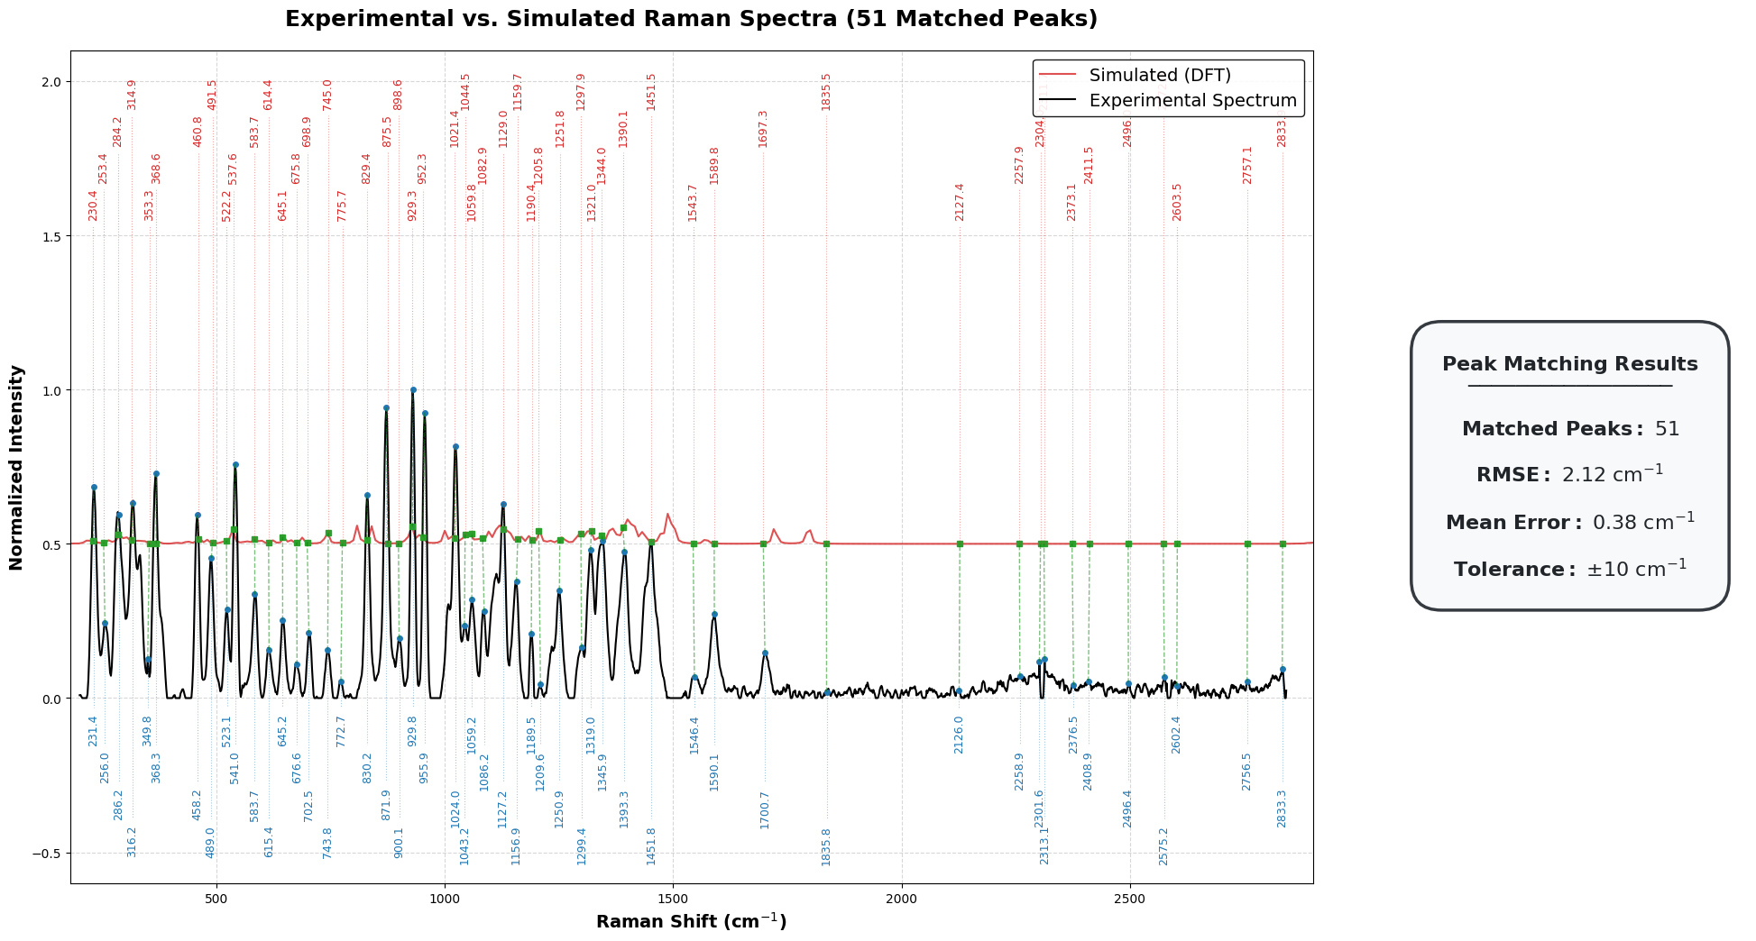
Experimental vs DFT Raman Spectrum (NAM)
Excellent agreement between experiment and simulation (RMSE ~2 cm⁻¹) validates DFT for biomarker detection

Slide 7
This validates your computational workflow.
Simulation vs Literature Simulation
Your Sim (cm⁻¹) | Literature (cm⁻¹) | Error | Assignment
216.1 | 214.2 | ~2 | CH rocking
282.5 | 292.7 | ~10 | Torsion
562.4 | 558.9 | ~3 | C–O bending
1009.5 | 1010.5 | ~1 | C–O–C stretch
1260.1 | 1233.8 | ~26 | Amide III
1508.0 | 1535.1 | ~27 | Amide II
1652.7 | 1677.0 | ~24 | Amide I
1725.1 | 1763 / 1677 | ~40 | Carbonyl
Strong agreement with literature-reported DFT frequencies confirms reliability of the simulation method.
IMPORTANT MATCHES 1. 1009.5 ≈ 1010.5 cm⁻¹
Perfect match From literature: ν(C–O–C)
This is: NAM SIGNATURE PEAK (ETHER / LACTYL GROUP)
2. 1652.7 ≈ 1676 cm⁻¹
Amide I Confirms: N-acetyl group
3. 1508 ≈ 1535 cm⁻¹
Amide II 4. 1347 ≈ 1318 cm⁻¹ CH bending
ERROR ANALYSIS
Observations:
Low region (<1000): ~2–30 cm⁻¹
Mid region: ~20–40 cm⁻¹
High region: ~20–50 cm⁻¹

Slide 8
Experimental vs Simulation
This validates your real measured NAM powder spectrum.
Experimental | Simulated | Difference | Assignment
284.3 | 282.5 | -1.8 | Ring deformation
772.7 | 777.8 | +5.1 | Ring / CH wagging
955.9 | 965.7 | +9.8 | Ring breathing
1155.4 | 1156.9 | +1.5 | C–O–C stretch
1249.4 | 1260.1 | +10.7 | C–N / OH deformation
1345.9 | 1347.4 | +1.5 | CH deformation
1451.8 | 1431.4 | -20.4 | CH₂ / CH₃ bending
1700.7 | 1725.1 | +24.4 | C=O stretch
The measured pure NAM powder spectrum shows strong agreement with theoretical vibrational modes across key fingerprint regions.
Strong Matches (Excellent Agreement)
Peaks with very small shift (≈0–5 cm⁻¹):
284.3 ↔ 282.5
772.7 ↔ 777.8
1155.4 ↔ 1156.9
1345.9 ↔ 1347.4

Slide 9
Larger Shifts
Observed in some peaks due to:
solid-state vs isolated molecule effects
hydrogen bonding
anharmonicity
basis set limitations
coupled vibrational modes
experimental environment
Conclusion
In the present study, Raman spectroscopy of high-purity N-acetylmuramic acid powder was used to establish the characteristic spectral fingerprint of NAM. Identification is based on the collective pattern of multiple Raman bands rather than any single peak, since individual vibrations may also appear in other biomolecules. Direct comparison with whole bacterial spectra is limited because bacterial samples contain proteins, lipids, nucleic acids, and other overlapping components. Therefore, the most appropriate validation is comparison between the experimental pure NAM spectrum and DFT-simulated NAM spectrum, where strong agreement was observed. The obtained pure NAM spectrum can now serve as a reference control for future analysis of complex biological or bacterial samples.

Slide 10
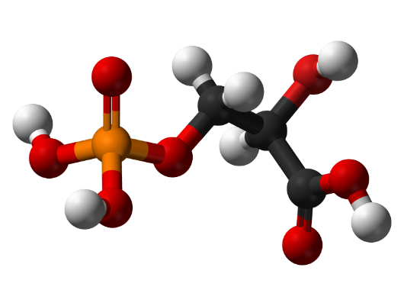
Lipoteichoic Acid
Challenge in LTA Simulation
LTA is a large polymeric biomolecule
Full DFT simulation → computationally impractical
Need a scientifically valid alternative approach
Component-Based Modeling Strategy
Decompose LTA into representative molecular units
Simulate each component using DFT
Combine spectral contributions to reconstruct LTA fingerprint
Structure of Lipoteichoic Acid
Lipoteichoic acid consists of three structural components:
• Glycolipid membrane anchor • Poly(glycerol–phosphate) backbone • Substituent groups such as D-alanine residues or sugars
“Fragment-based modeling is a standard approach for large biomolecules”

Slide 11
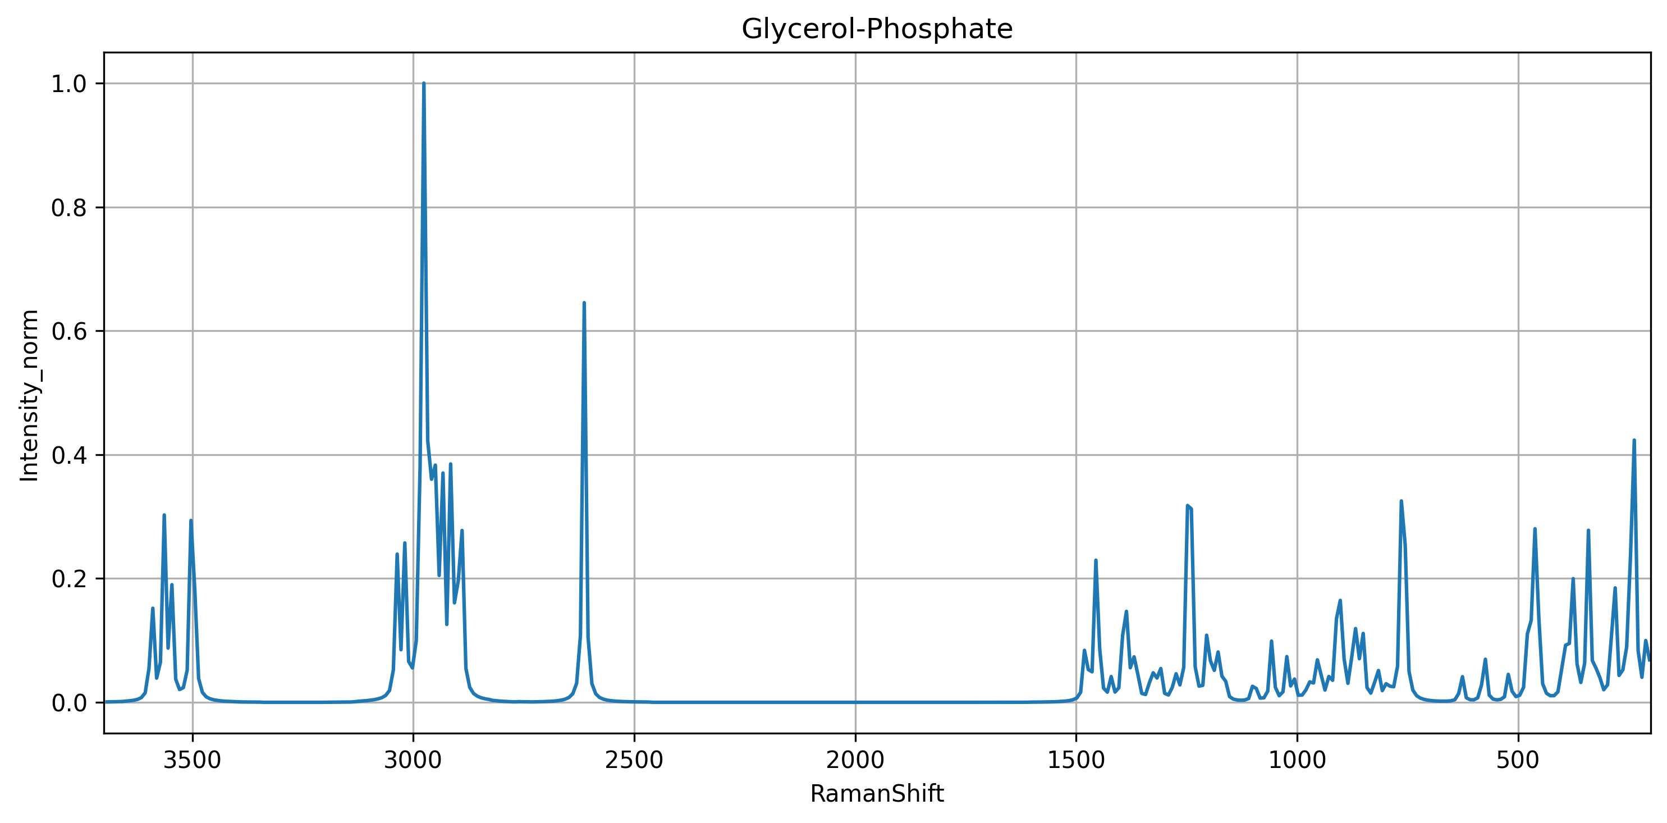
DFT Simulation Method
Quantum-chemical calculations were performed using Gaussian 16.
The simulation included:
• geometry optimization • vibrational frequency calculation • Raman activity calculation
Parameter | Value
Functional | B3LYP
Basis set | 6-31G(d)
Solvent model | SMD (water)
Gaussian keywords used:
# B3LYP/6-31G(d) Opt Freq Raman SCF=Tight Int=UltraFine SCRF=(SMD,Solvent=Water)
Explanation:
SCF=Tight ensures strict electronic convergence
Int=UltraFine improves numerical accuracy
SCRF=SMD models the aqueous environment in which LTA normally exists
DFT frequencies typically overestimate vibrational frequencies, so a scaling factor is applied.
Scaled frequency = frequency × 0.96

Slide 12
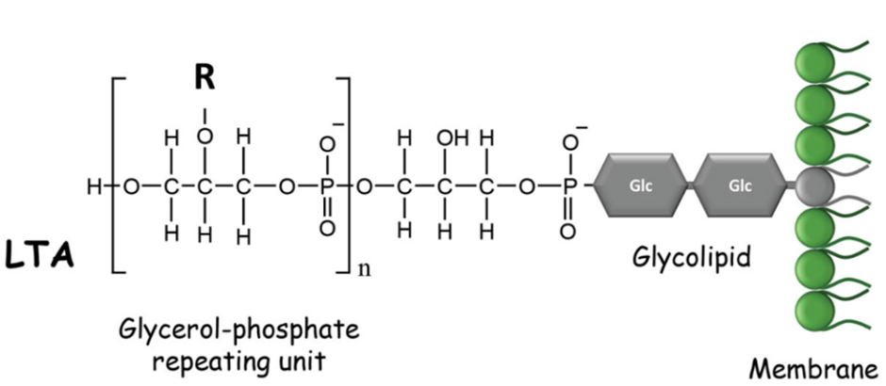
The backbone is composed of repeating units:
glycerol – phosphate – glycerol – phosphate
Typical LTA molecules contain 10–20 repeating glycerol–phosphate units, producing large polymers with hundreds of atoms.
Because the full polymer is computationally expensive for quantum simulations, smaller molecular fragments are often used to represent the local chemical environment responsible for Raman-active vibrations.
General structure:
Lipid anchor – (Gro–P)ₙ
where: Gro = glycerol P = phosphate
LTA contributes to:
bacterial adhesion
cell wall maintenance
activation of host immune responses through receptors such as Toll-like receptor 2

Slide 13
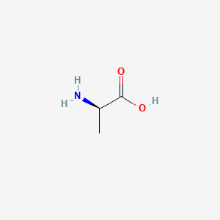
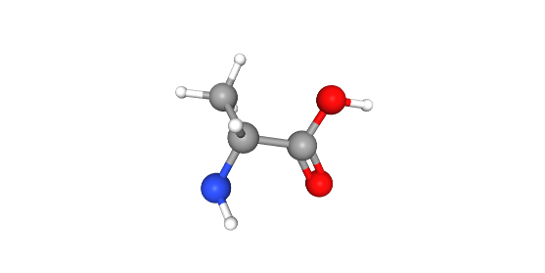
Modeling the LTA Substituent: D-Alanine
Why D-Alanine?
• Represents amino substituent in LTA • Responsible for surface charge regulation • Important for Gram-positive bacterial identification
Molecular Characteristics
2D Structure
• Exists in zwitterionic form: NH₃⁺ – COO⁻ • Contains:
Amino group
Carboxylate group
Methyl group
DFT Simulation Method
• Geometry optimization + Raman calculation • Functional: B3LYP • Basis set: 6-31G(d) • Solvent: SMD (water)
3D Structure

Slide 14
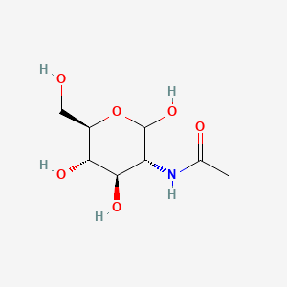
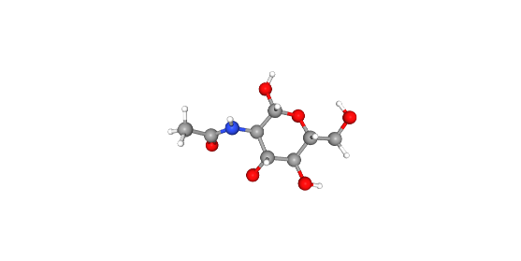
Modeling the LTA Substituent: GlcNAc
Why GlcNAc?
• Represents carbohydrate component • Present in bacterial cell wall structures • Provides strong Raman-active sugar signals
Molecular Characteristics
2D Structure
• Pyranose ring structure • Contains:
Multiple hydroxyl groups (–OH)
Acetamide group (–NHCO–)
C–O–C linkages
DFT Simulation Method
• Geometry optimization + Raman calculation • Functional: B3LYP • Basis set: 6-31G(d) • Solvent: SMD (water)
3D Structure

Slide 15
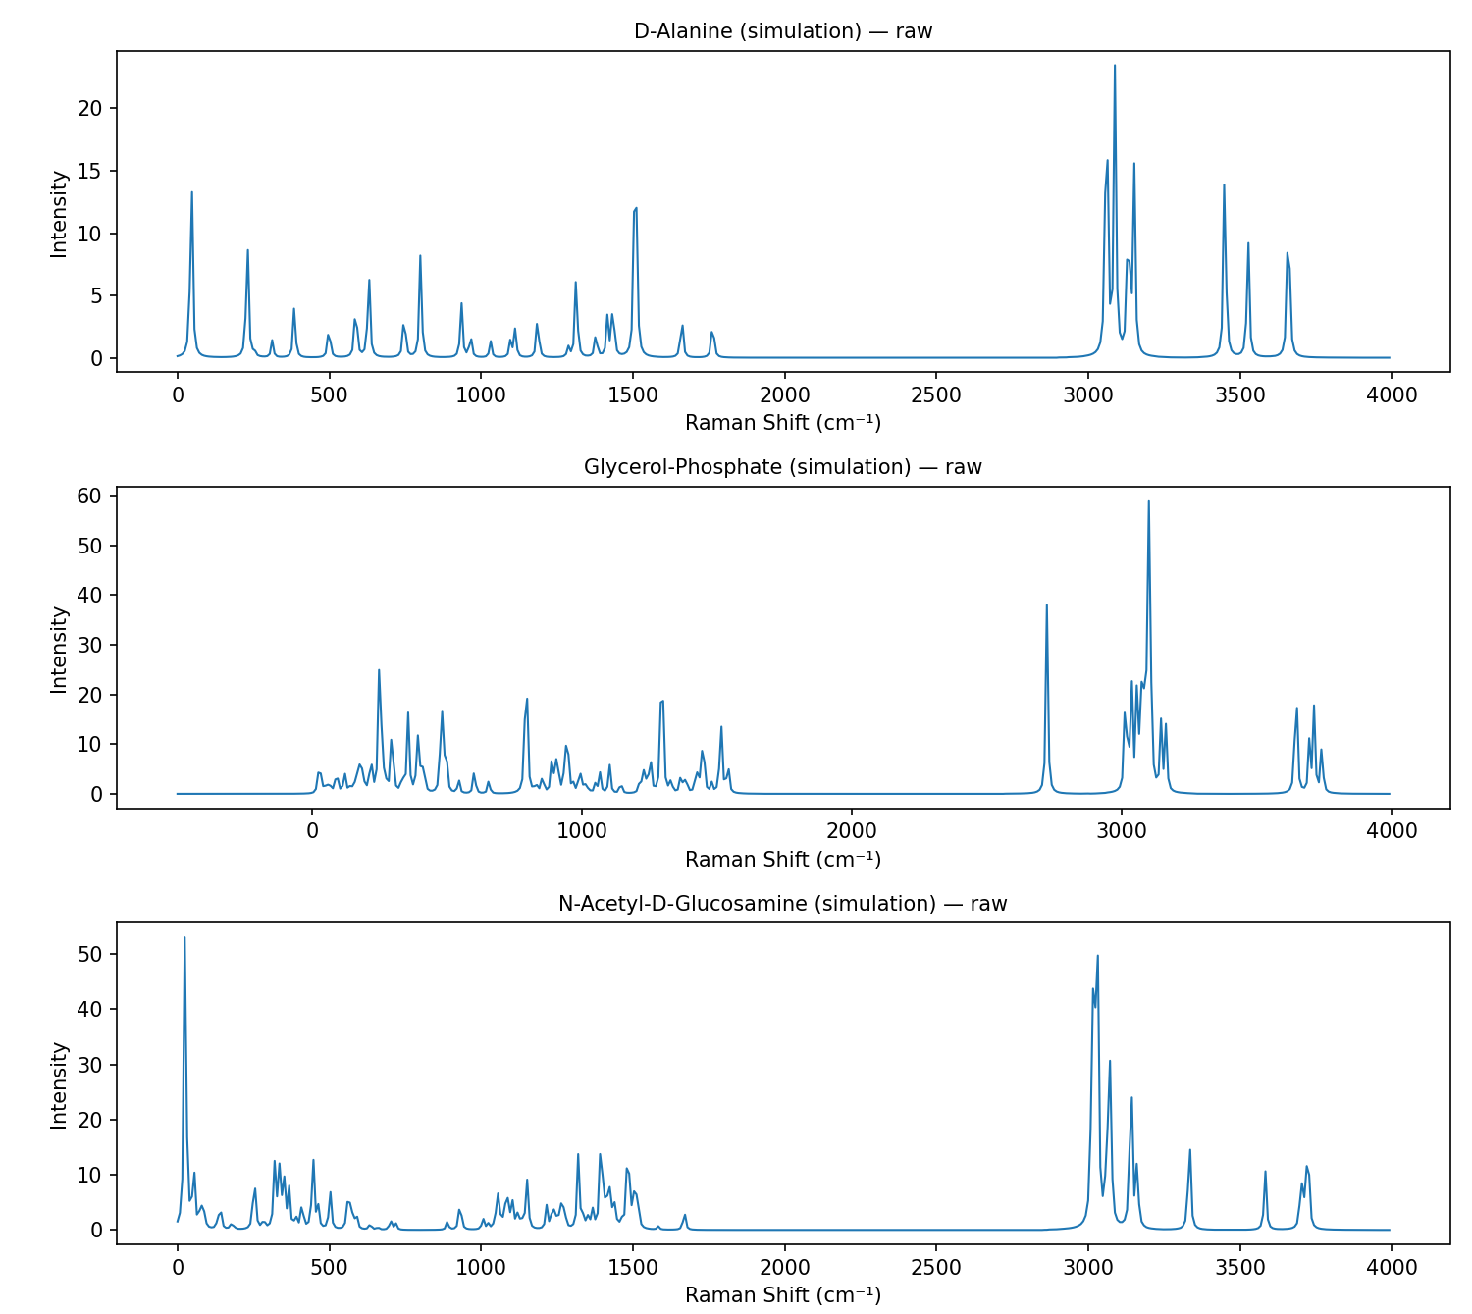
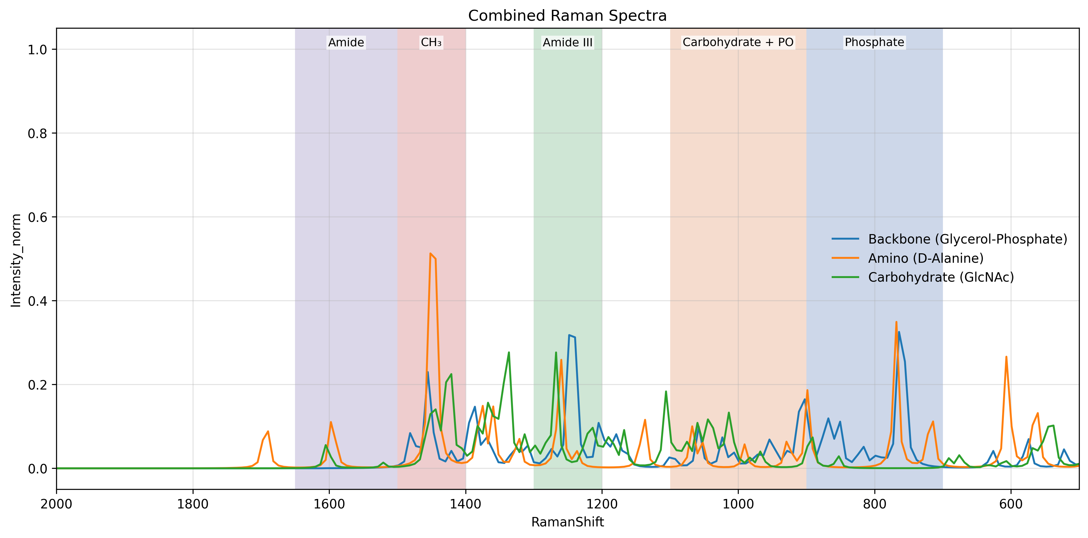
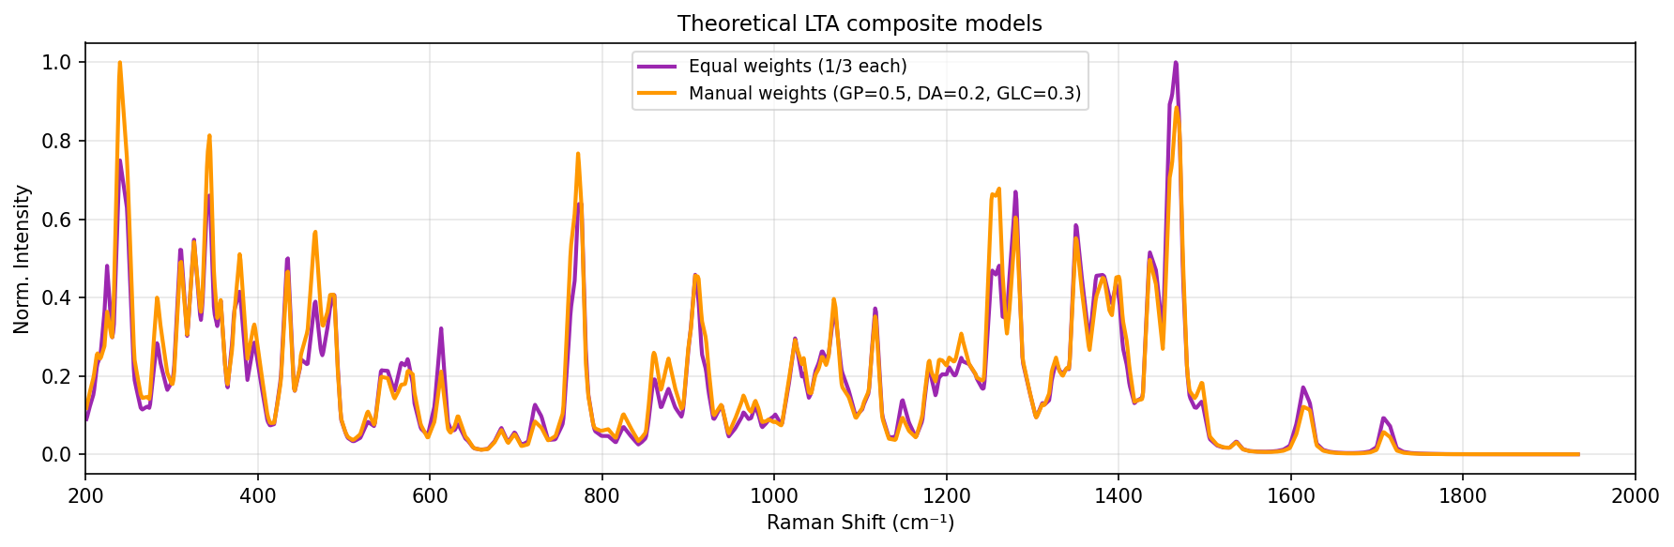

Slide 16
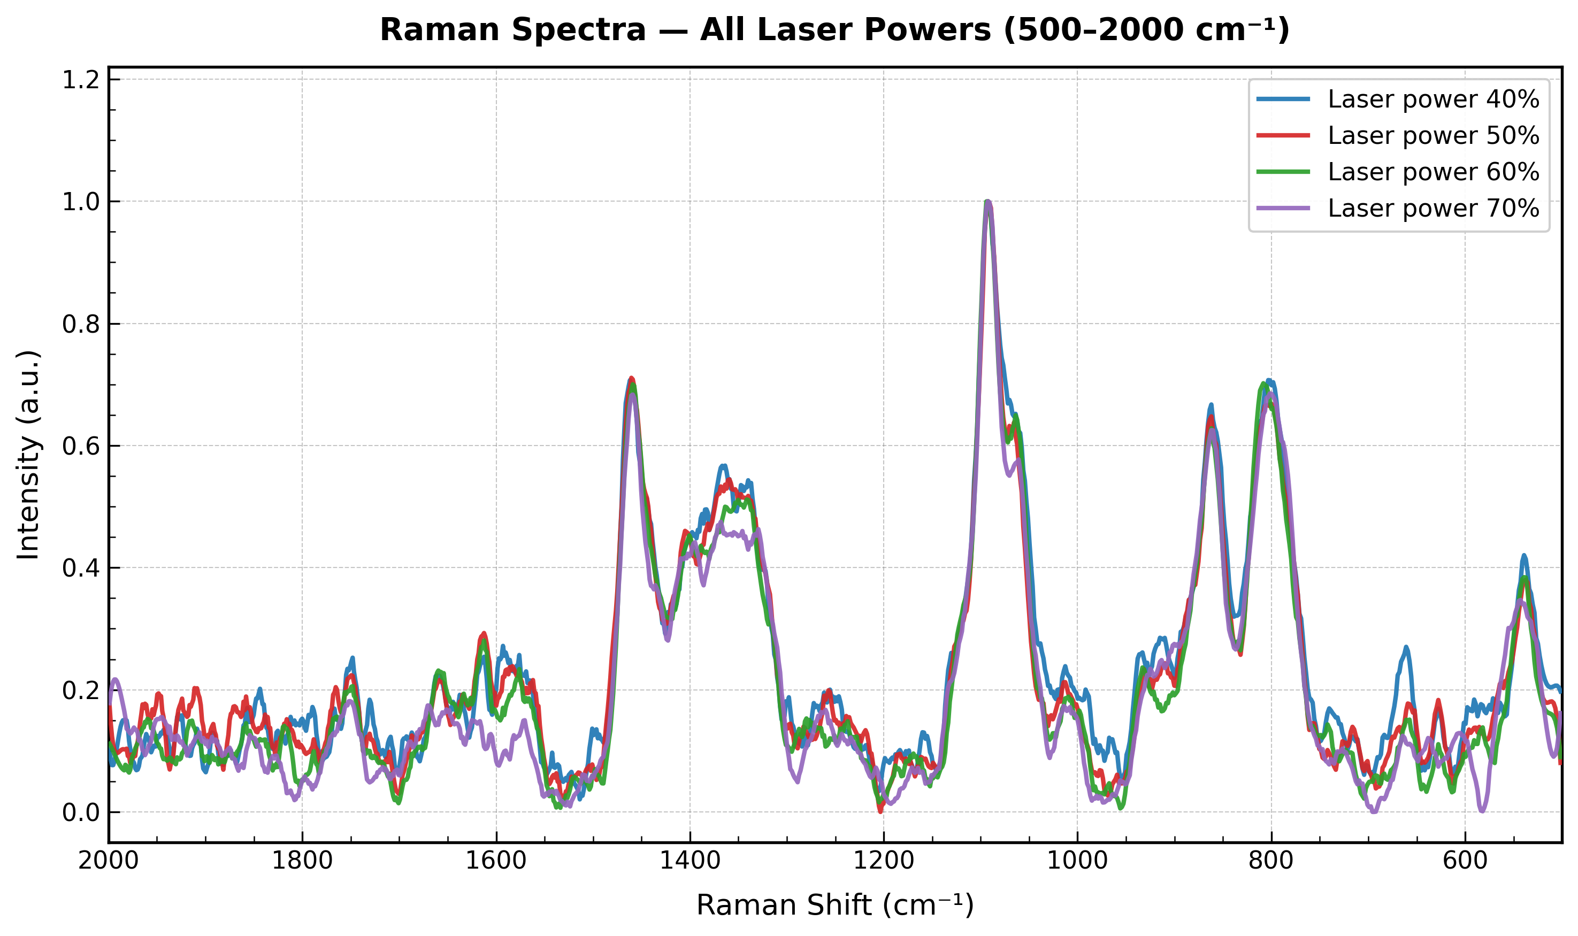
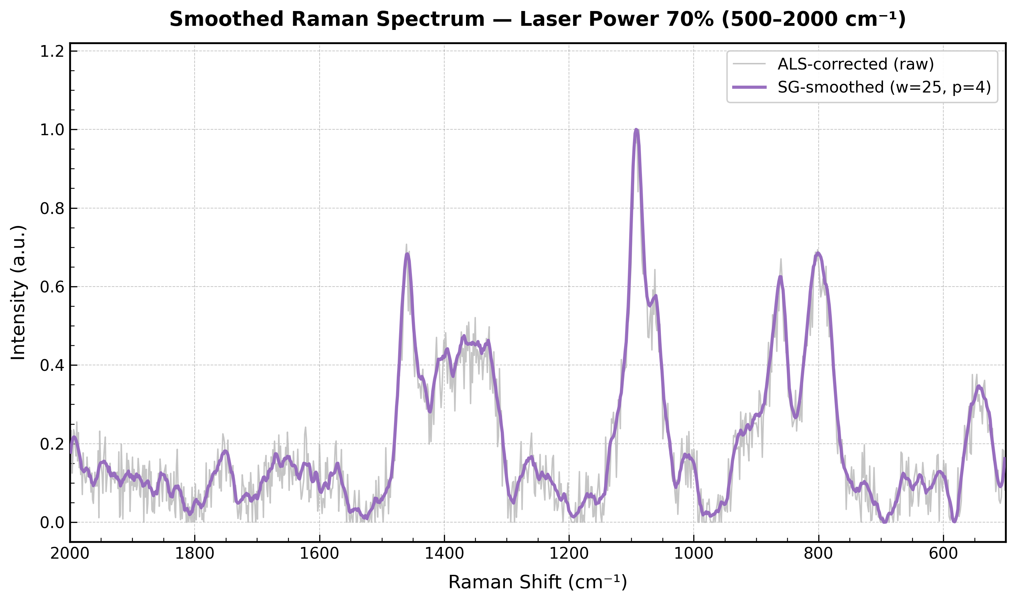
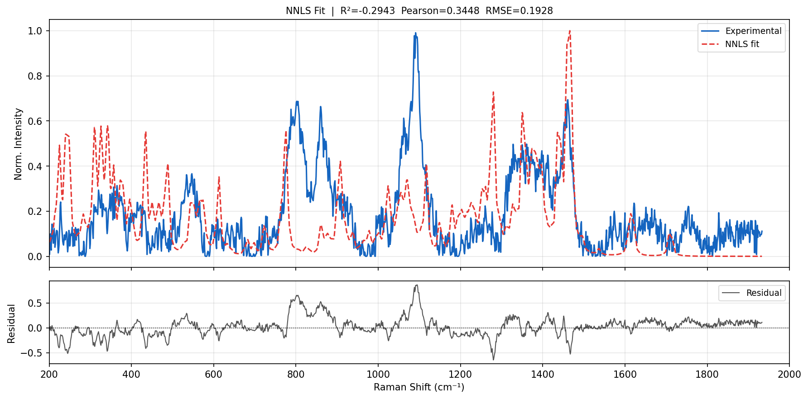

Slide 17
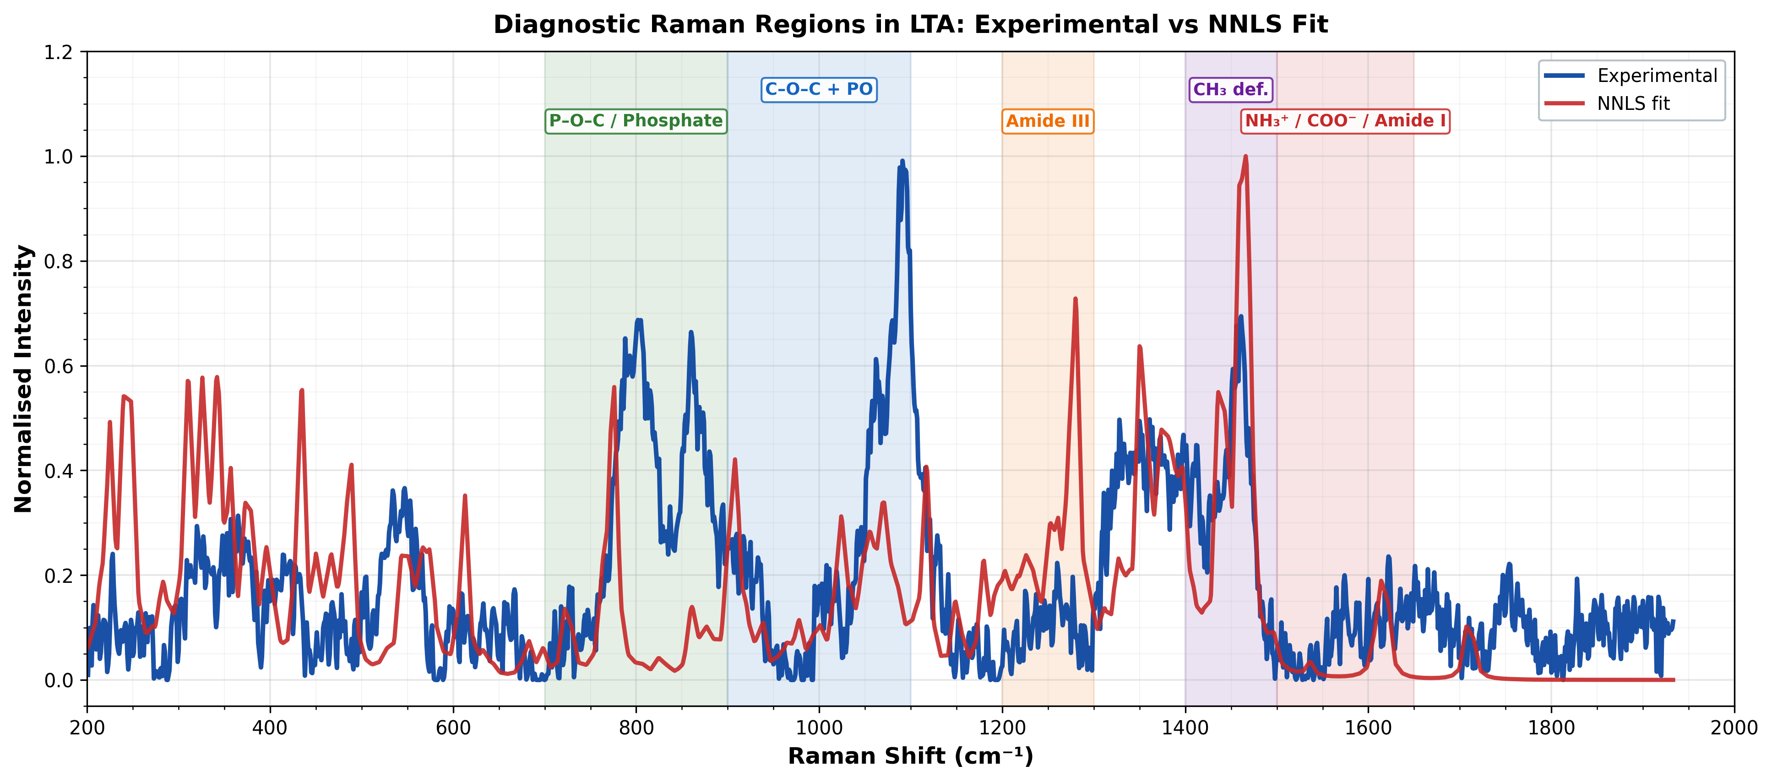

Slide 19
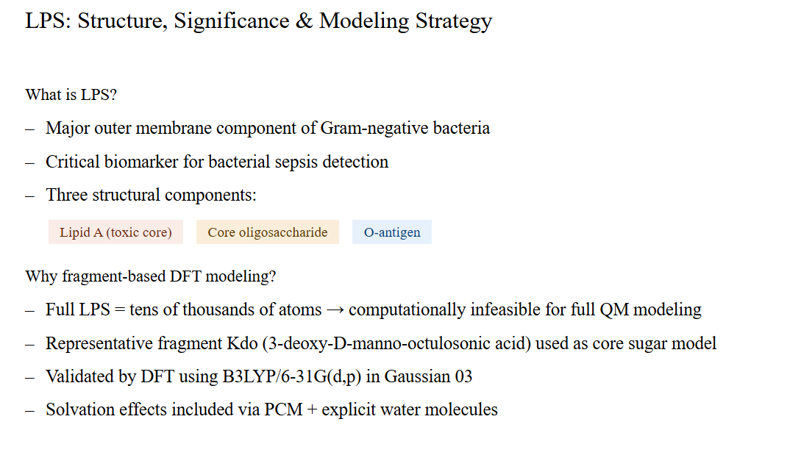
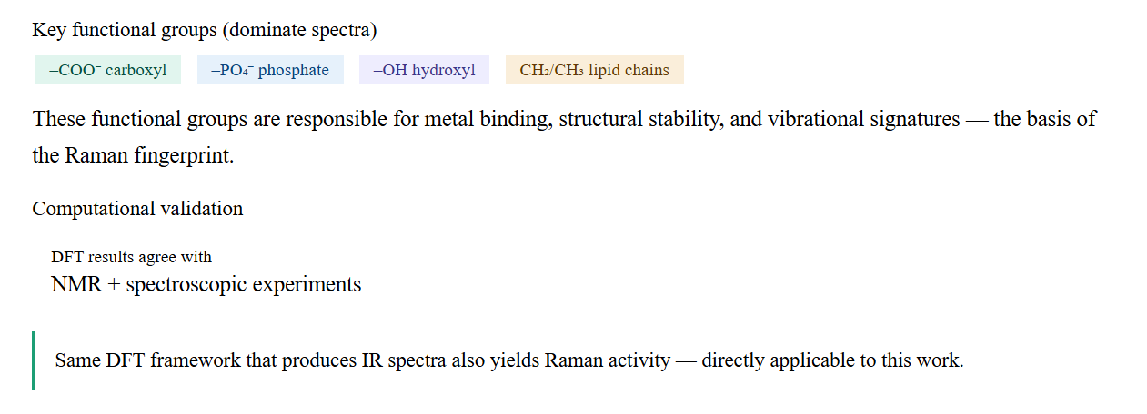

Slide 20
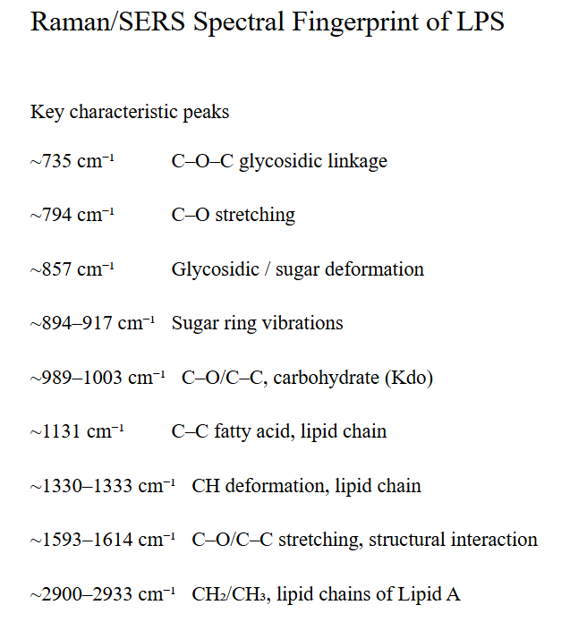
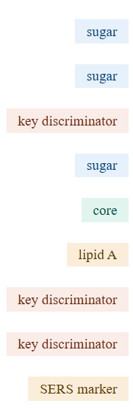

Slide 21
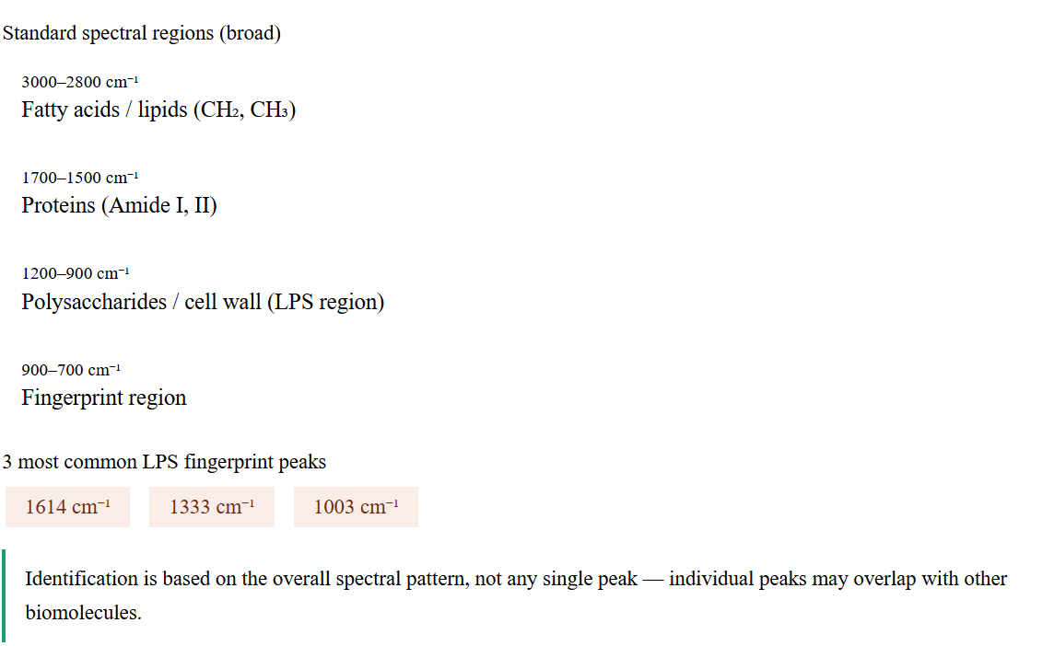

Slide 22
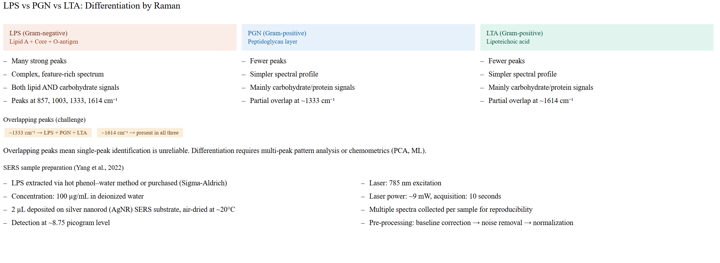

Slide 23
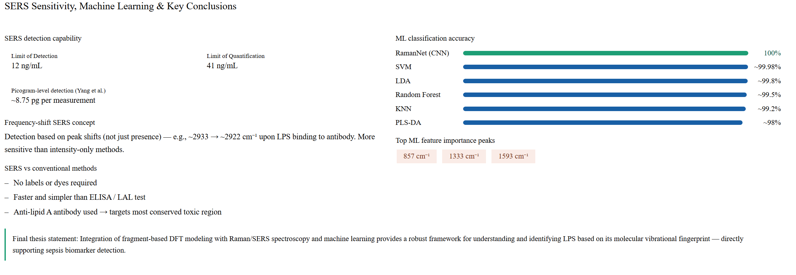

Slide 24
Background
Lipopolysaccharide (LPS) is a major component of Gram-negative bacterial outer membranes.
It is strongly associated with inflammation, endotoxemia, and sepsis.
Rapid identification of LPS-related spectral fingerprints can support diagnostic research.
Raman spectroscopy provides label-free molecular fingerprinting.
Problem Statement
Full LPS is structurally large and complex.
Direct spectral interpretation is difficult due to overlapping bands and multiple functional groups.
Objective
Acquire Raman spectra of LPS powder under optimized conditions.
Build fragment-based computational models representing major LPS substructures.
Compare simulated and experimental spectra.
Identify dominant contributors and characteristic Raman bands.

Slide 25
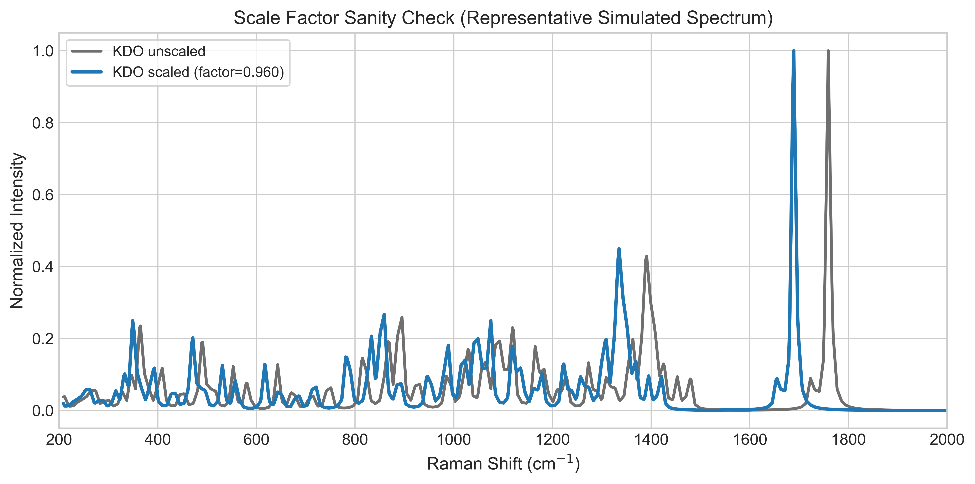
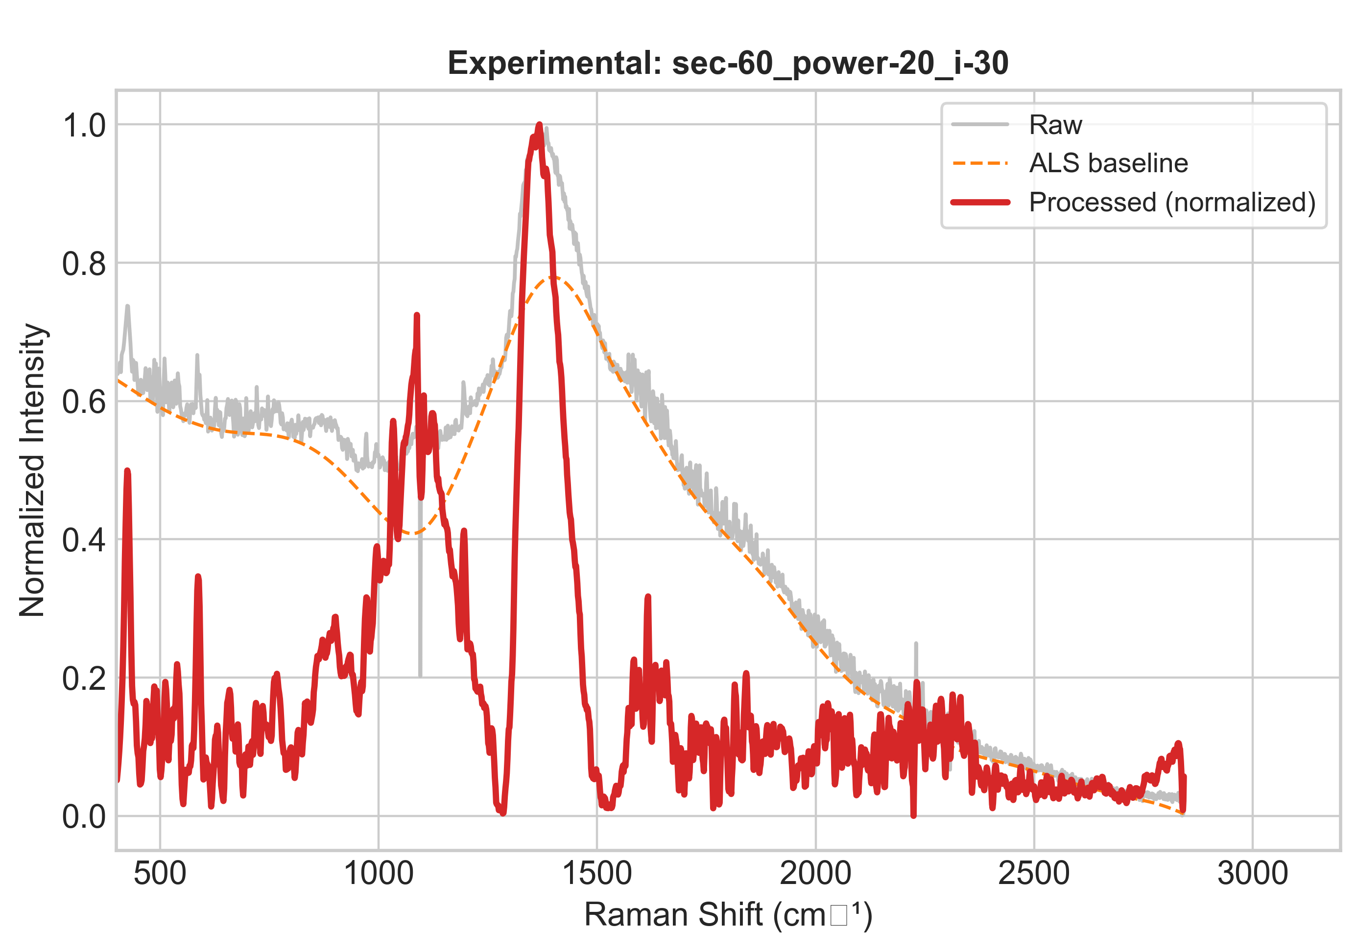
Experimental Workflow
Sample: LPS powder
Raman measurements performed under multiple acquisition settings:
Different integration times
Different laser powers
Different accumulations
Best experimental condition selected based on signal quality and reproducibility.
Optimized Condition Chosen
60 s integration
20% laser power
30 accumulations
Computational Workflow
Representative fragments selected:
KDO
Heptose
D-Glucosamine
Myristic Acid
Phosphoric Acid

Slide 26
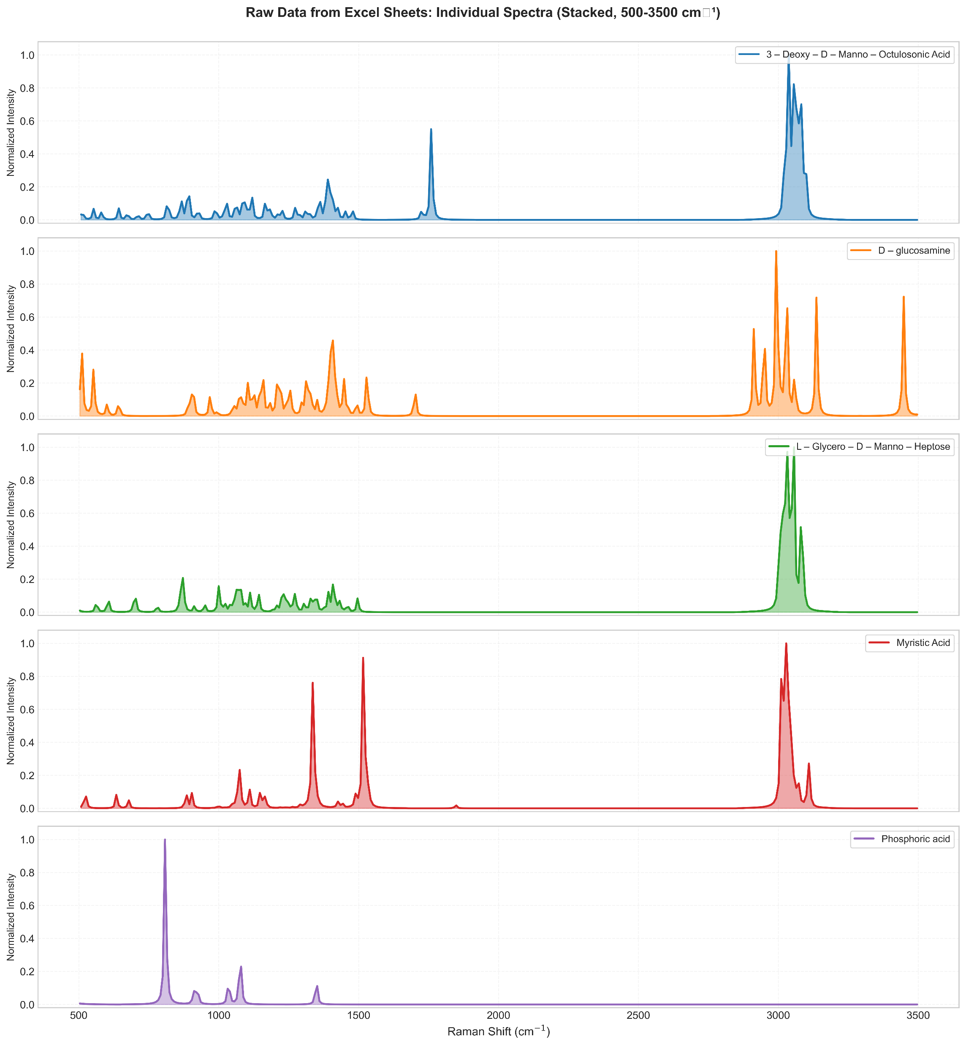
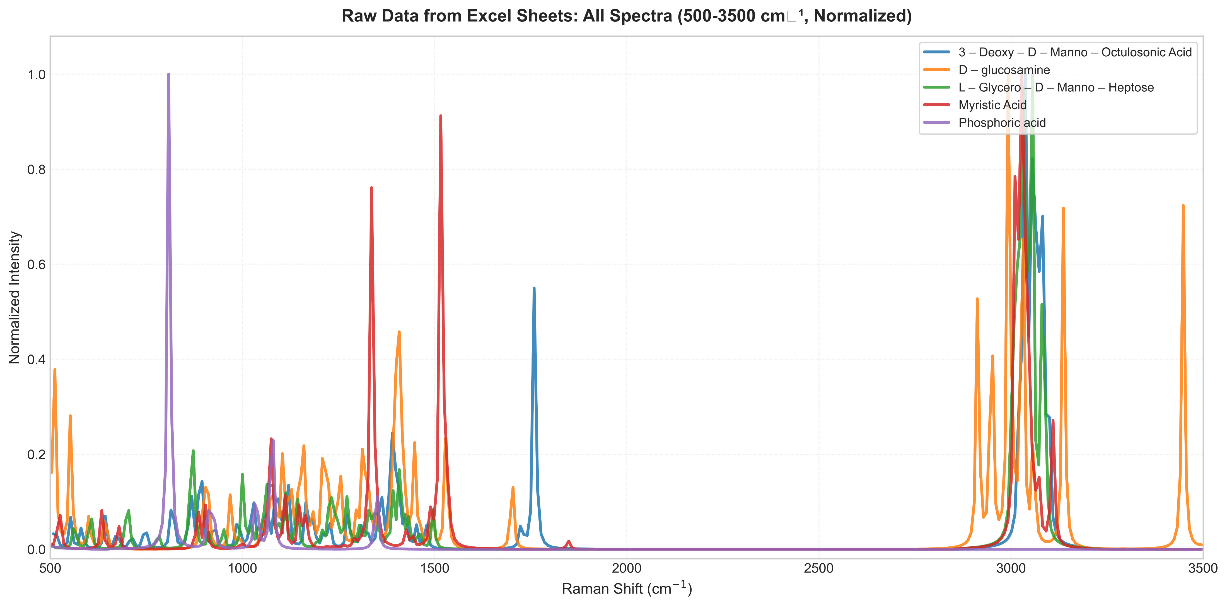
Simulation Method
Geometry optimization
Frequency + Raman calculations
DFT using B3LYP / 6-31G(d)
Data Processing
Interpolation to common Raman grid
Normalization
Composite model generation:
Equal-weight model
NNLS optimized model

Slide 27
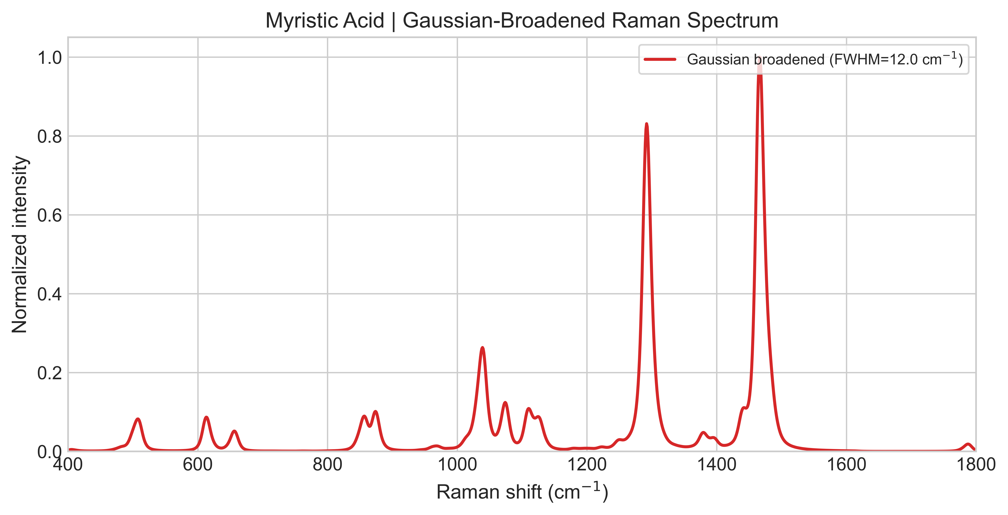
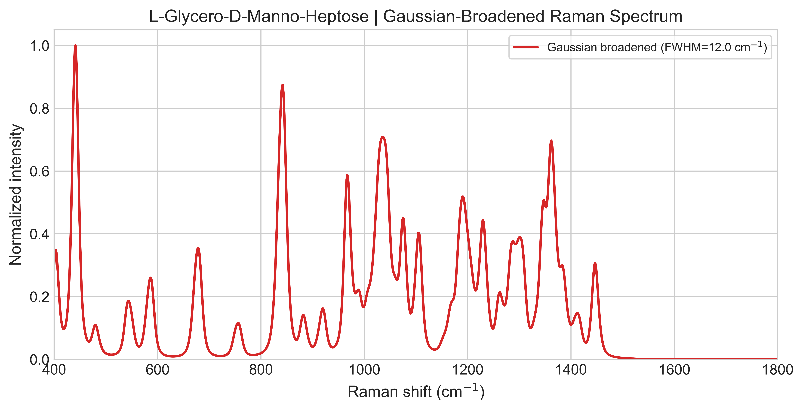
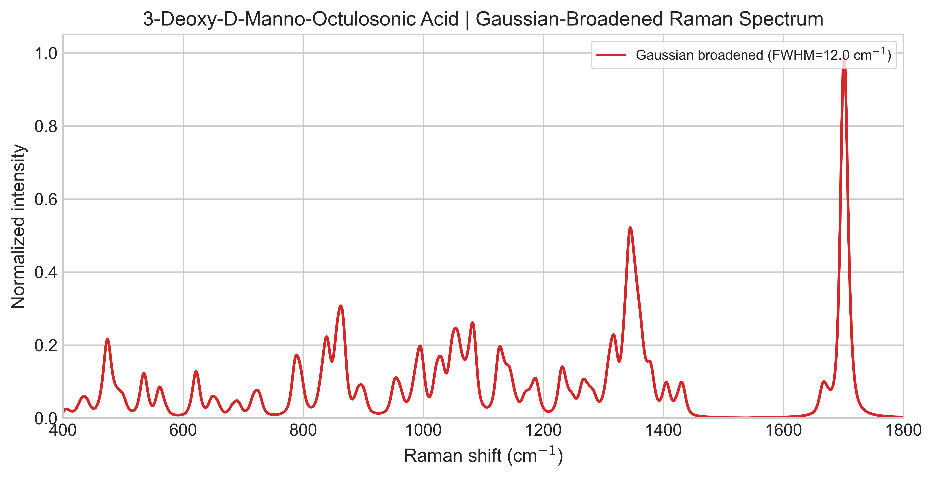
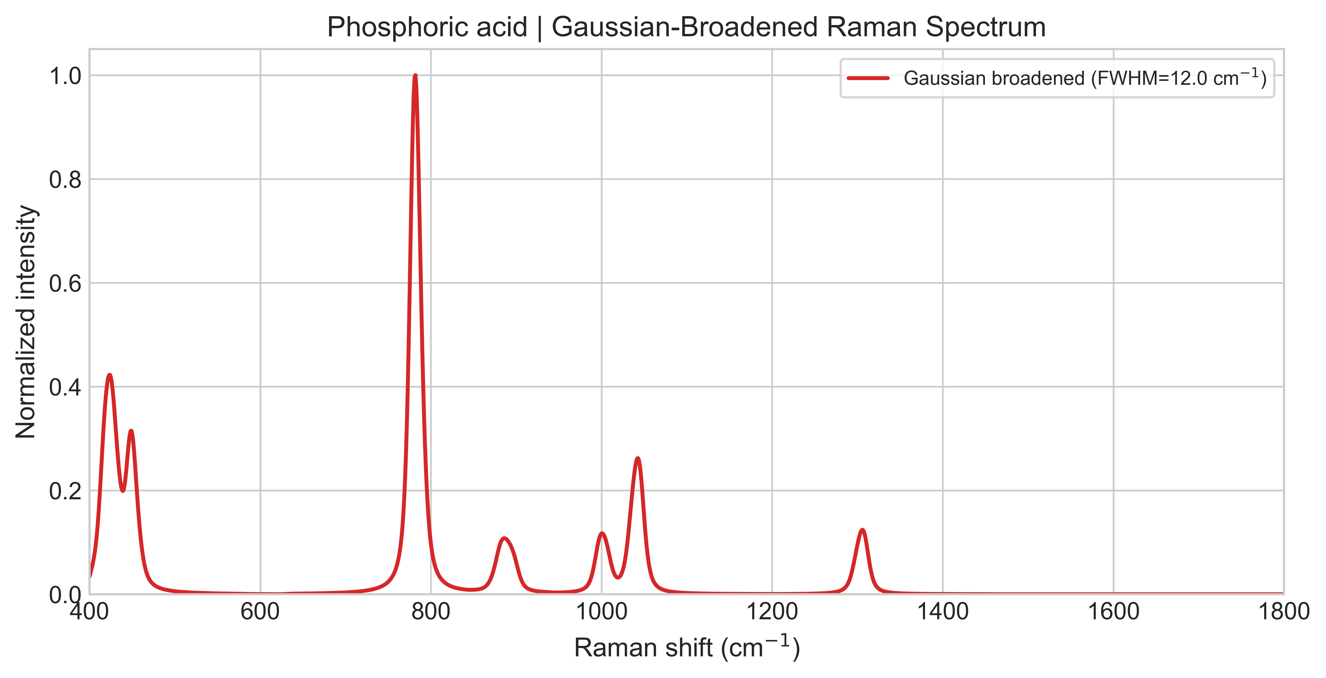
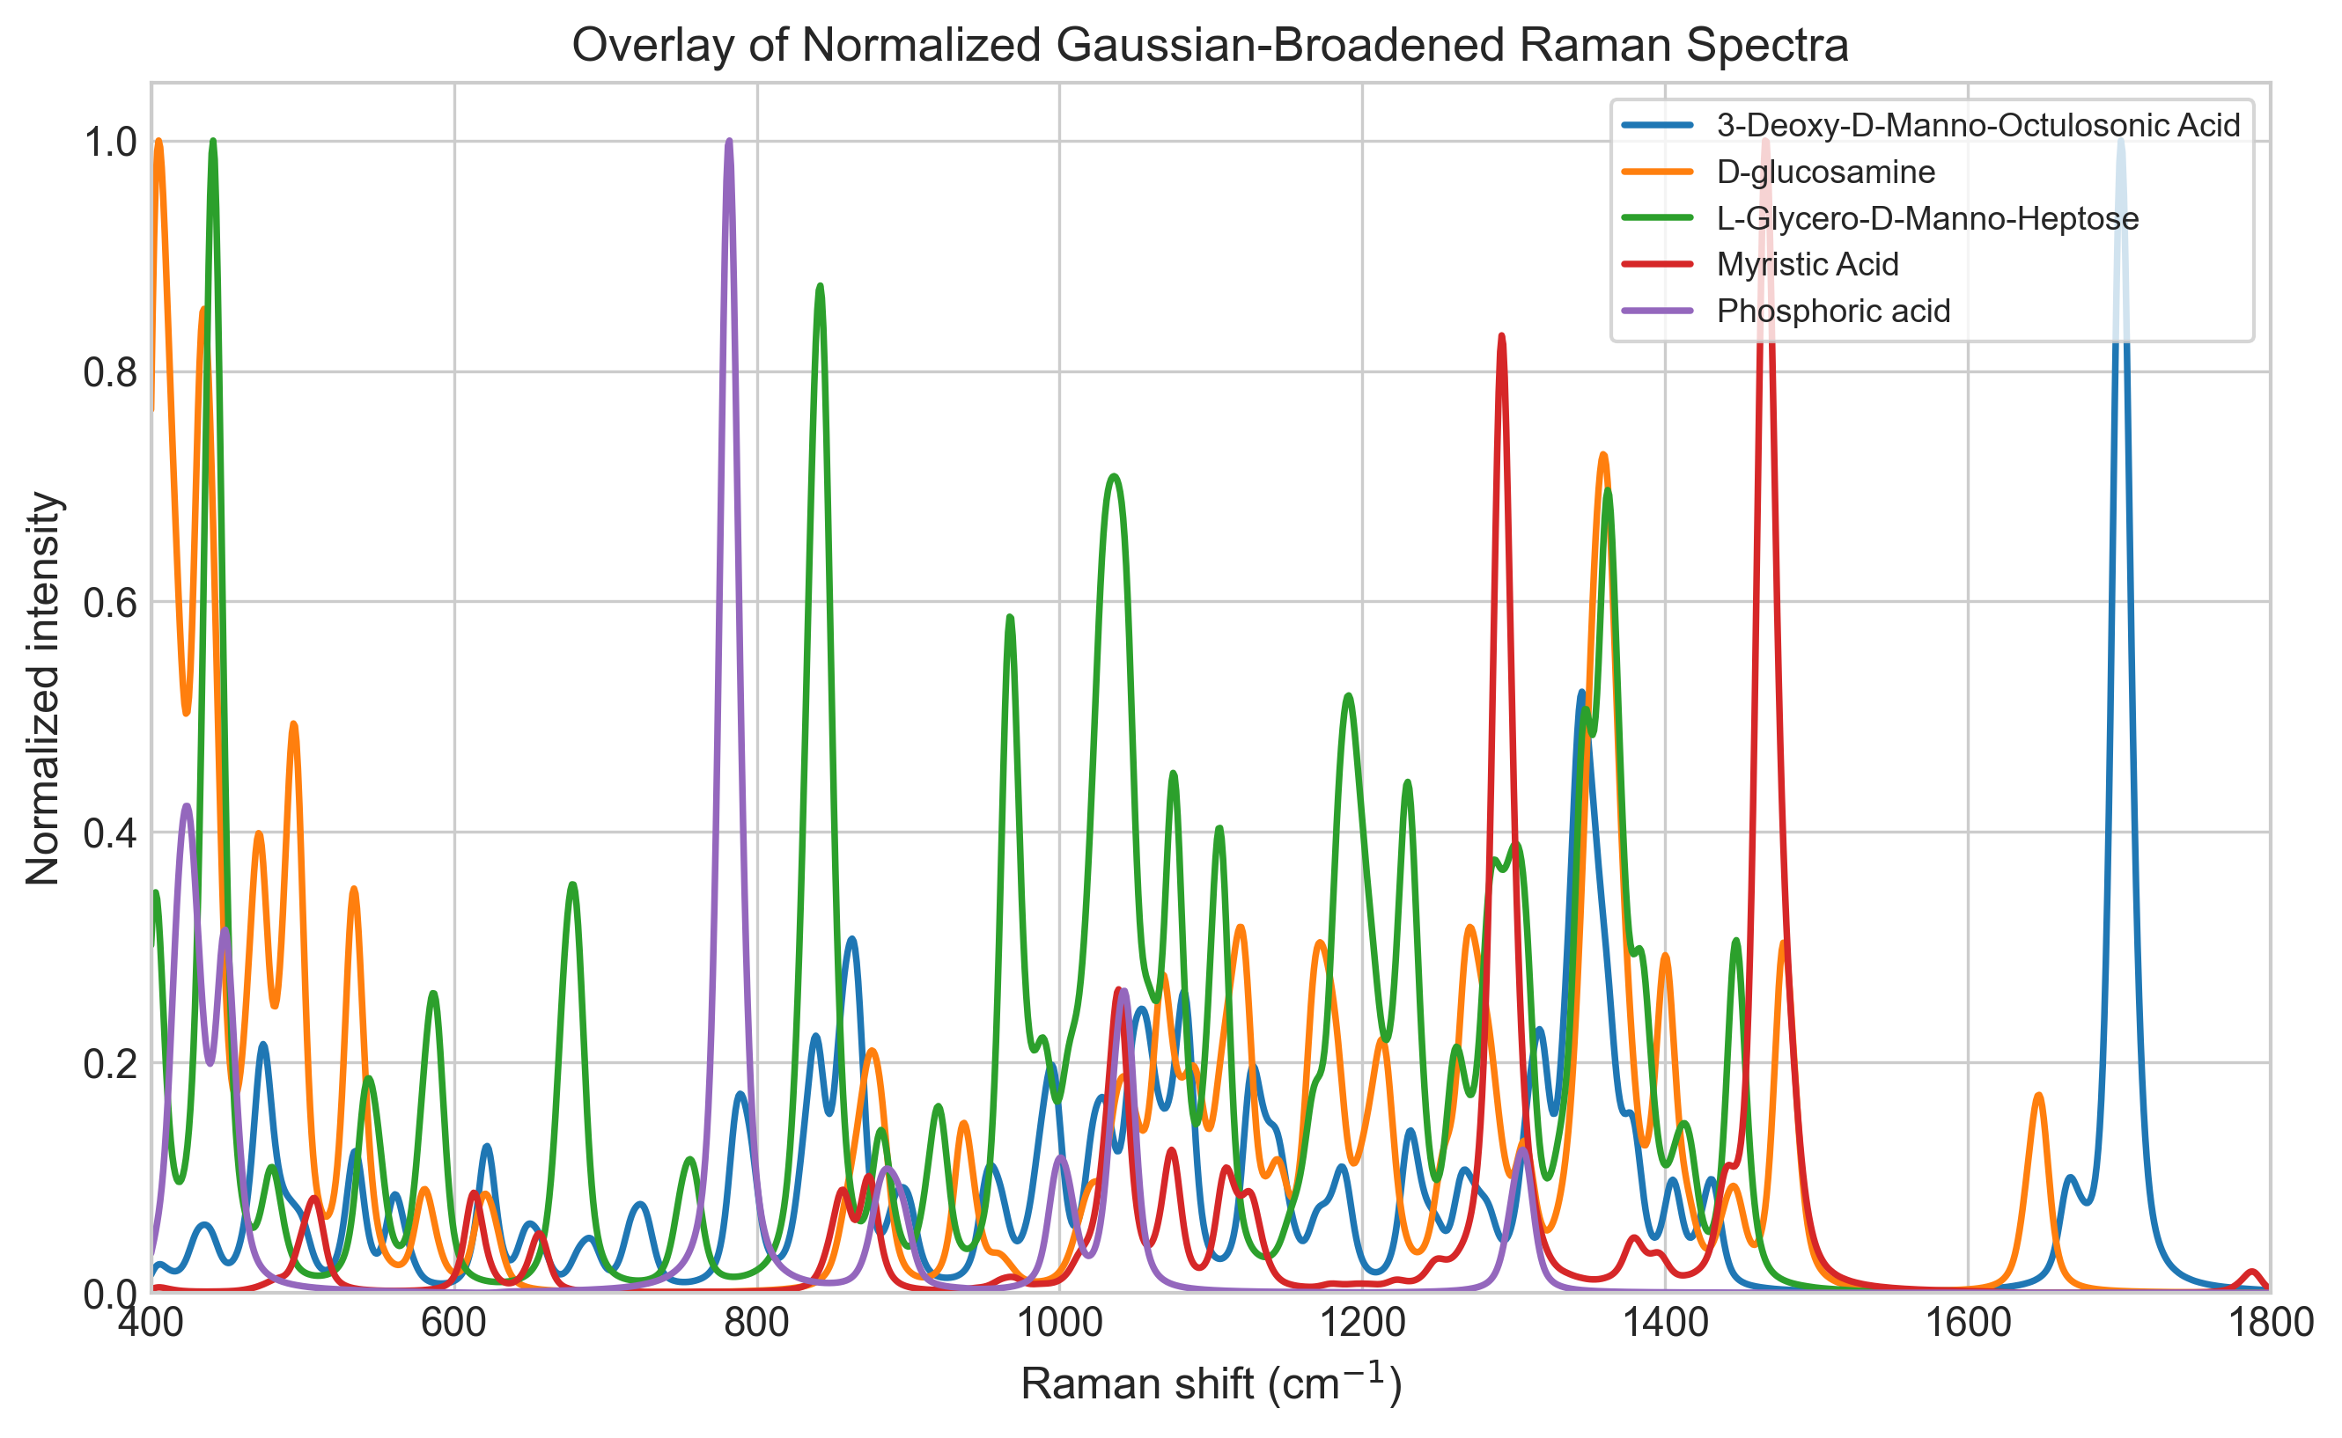
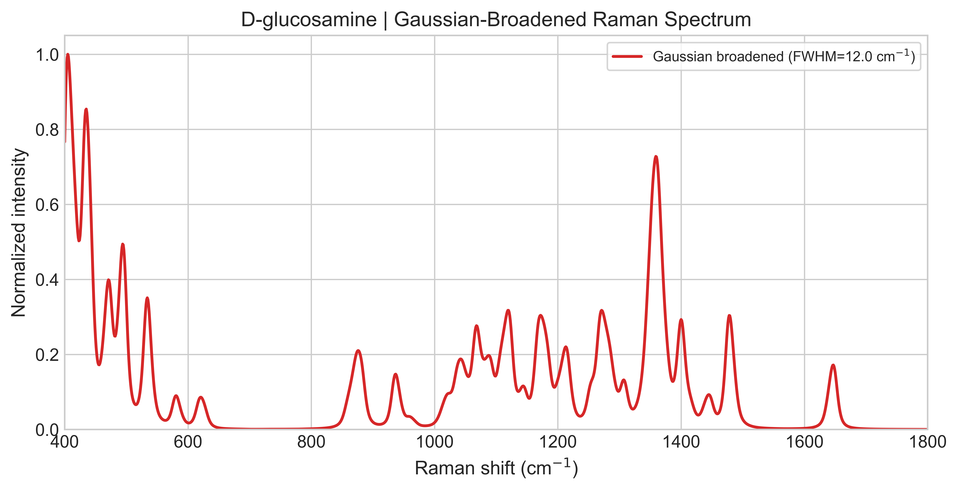

Slide 28
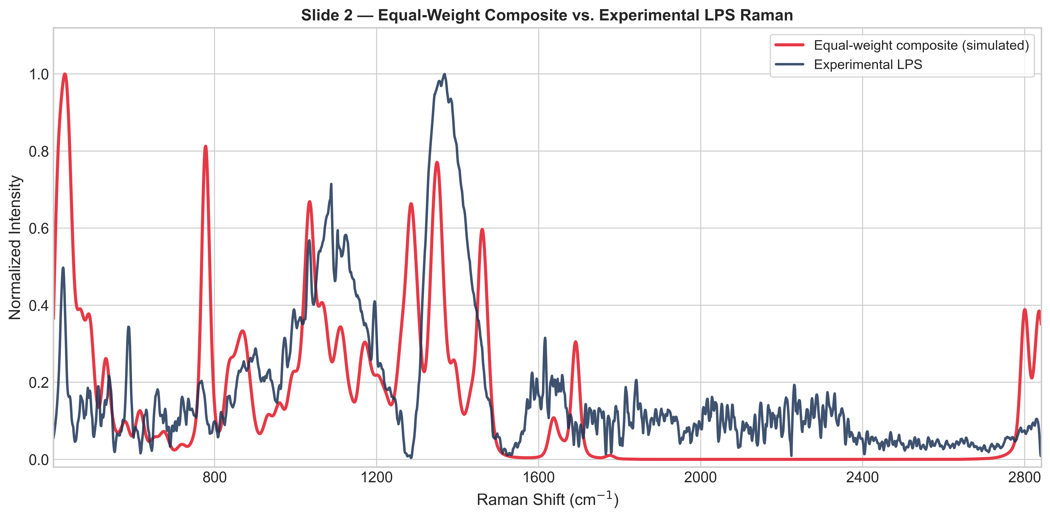

Slide 29
